Slide 1
SMART ATTENDANCE SYSTEM
Submitted in the partial fulfillment for the award of the degree of
BACHELOR OF ENGINEERING
IN
COMPUTER SCIENCE AND BUSINESS SYSTEMS
Submitted by:
NAVYA ARORA (19CBS1027) SPARSH PHUTELA (19CBS1016) MAHIN MODI (19CBS1076 )
Under the Supervision of:
PROF. CHITRANJAN PRASAD SAH
Department of AIT-CSE
DISCOVER . LEARN . EMPOWER

Slide 2
Outline
Introduction to Project
Problem Formulation
Objectives of the work
Methodology used
Results and Outputs
Conclusion
Future Scope
References

Slide 3
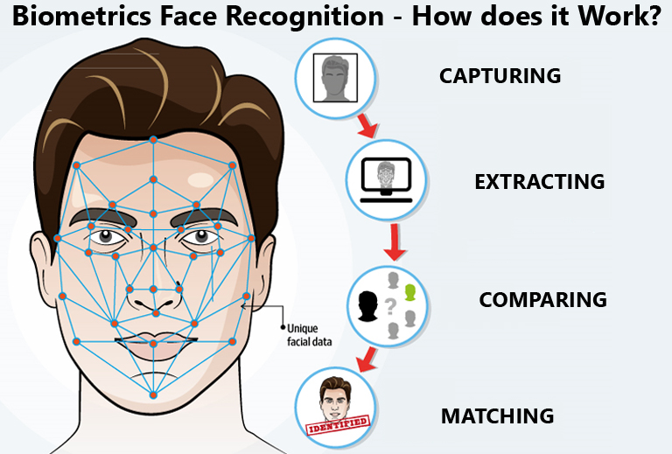
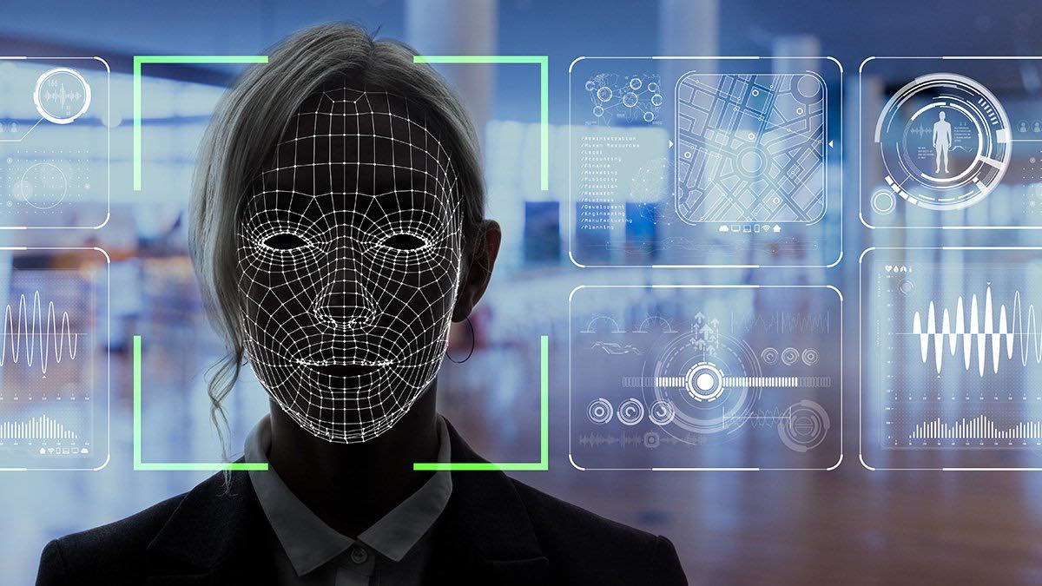
Introduction to Project
Every college require an attendance system to maintain record of present student.
Face Recognition Attendance System is developed for the Faculty to maintain attendance record.
Attendance is defined as an act or condition of regular attendance or presence at a place or event. The presence of every student is maintained by schools and colleges. The personal record system does not work and extra time is needed to record and calculate each student's attendance. So a plan is needed that will solve the problem of personal presence. While advancing in the digital age is accelerating every hour, biometric technology has begun to impact daily human life. Biometrics technology uses features such as fingerprints, facial irises, retina patterns, palm prints, voice, handwritten signatures, and more for verification.
It uses facial recognition technology to identify the person’s facial features and automatically mark attendance which is very fast enough than previous. .

Slide 4
Problem Formulation
The concept of face recognition is to give the computer system the ability to detect and see a person's face quickly and accurately in photos or videos. Many algorithms and techniques have been developed to improve the performance of facial recognition.
Recently, in-depth reading has been extensively tested in computer vision systems. The human brain can detect and detect multiple faces automatically and instantly. But when it comes to computers, it is extremely difficult to perform all the challenging tasks at the human brain level.
Face detection is an important part of biometrics. In biometrics, human features are compared to existing data. Face features are extracted and applied using algorithms, such as successfully and some changes were made to improve existing algorithm models. Detectors and face detectors can be used in many different programs including crime detection, security systems, identity verification etc.
Face recognition the process usually consists of two phases:
Face Recognition - where the inserted image is searched to find any face, and then an image processing cleans the face image so that it can be easily seen.
Face detection - where the detected and processed face is compared to a known face website to determine who the person is.

Slide 5
Objectives of the Work
The program aims to create an effective classroom approach using face recognition techniques. The proposed program will be able to mark attendees at the event with a face id.
It will see faces with a webcam and see faces. Upon recognition, it will mark the presence of a known student and update the attendance record.
The main objective of the project is to establish a better future for the coming generation. For our teachers & for our students, we want better future & our project is one of the best medium for it.
Our program aims to create an effective classroom approach using face recognition techniques and our vision.
The proposed program will be able to mark attendees at the event with a face id. It will see faces with a webcam and see faces. Upon recognition, it will mark the presence of a known student and update the attendance record.

Slide 6
Methodology used
Having a video sequence as the input to the system the details of face detection, facial features extraction, normalization of facial features and quality score assignment are described in the following subsections:
Face Detection: For better face-to-face facial recognition, we have used the face tracking method. What we did was first find the face using Viola and Jones' view as described, and then use the compilation tracker from the dlib library to track the face from frame to frame. This method also saves the calculation power as we do not need to find a face after switching to a new real-time video sequence frame. This helps to produce face-log i.e., a short representation of the title of the title in video sequence.

Slide 7
Parameters: As people move around and look at different directions in front of the real-time camera, there may be a variety of headsets aimed at different angles. But because of biometrics, it is important to have a slightly modified face as a feature throughout the face-log.
It is therefore important to include this feature in facial quality testing. We determined the position of the head using three angles: Roll, Yaw, Pitch. All of these angles are usually in the middle -90 to + 90. The roller and the voice are adjusted in a coordinated manner during the production of the facial log, so the only thing that worries us is the yaw angle. We use the detection of landmarks on the face, counting the tips of the nose tip and the point between the eyebrows.

Slide 8
Sharpness: It is very likely to have blurry images in real time video sequences because the faces are moving. Thus it is important to include this feature in face quality assessment. To compute the sharpness of an image, we utilized the variance of an image Laplacian
Brightness: Changes in Lightening conditions are quite common in real-time applications like surveillance cameras. It is easier to apply Local feature extraction on brighter faces than on darker faces. Thus, it is necessary to include this feature in face quality assessment.
Representation : Deep Learning
Face representation is the core of the recognition algorithm used in this system. The face image captured after the quality assessment is needed to be represented in form of feature for further processing. The pre-processed images are too high-dimensional for a classifier to take directly on input. To obtain a low-dimensional distinct feature from the face images we used Convolution Neural Network (CNN), popularly known as deep learning. A deep network is a feed-forward network comprising of many function compositions, or layers. The network is provided with a loss function L. The loss function measures how accurately the neural net-work classifies an image

Slide 9
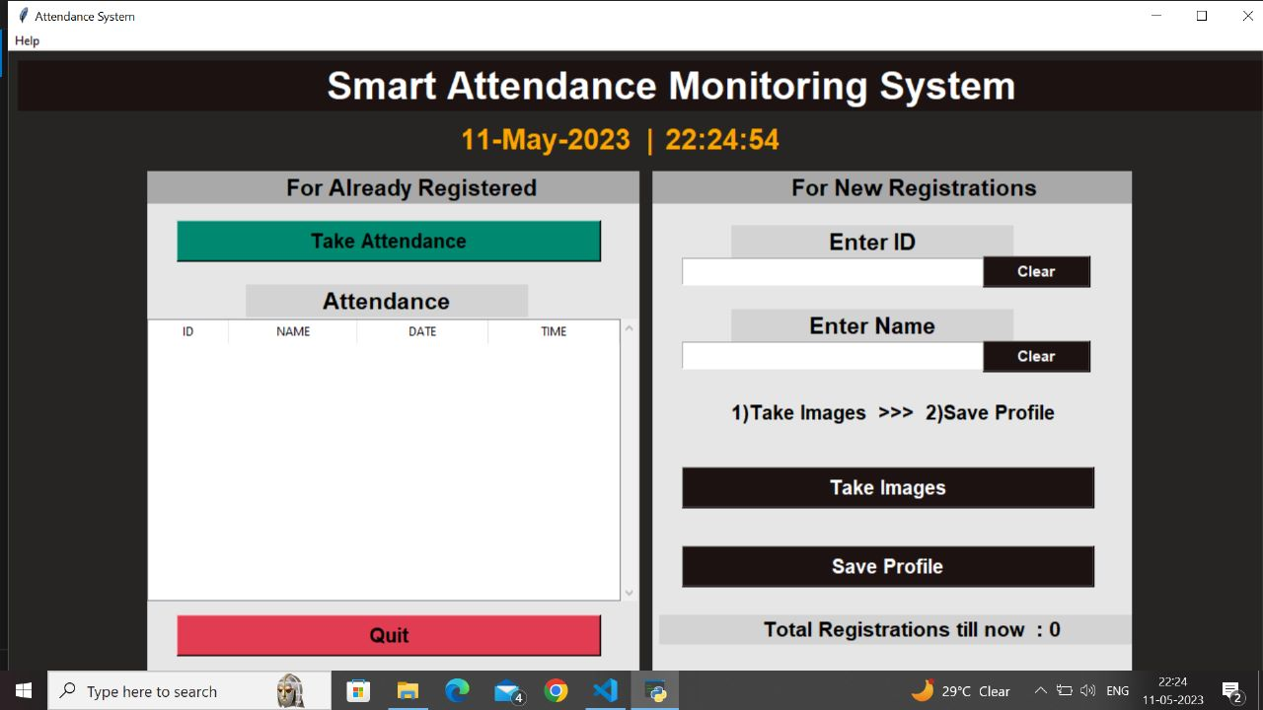
Results and Outputs

Slide 10


Slide 11
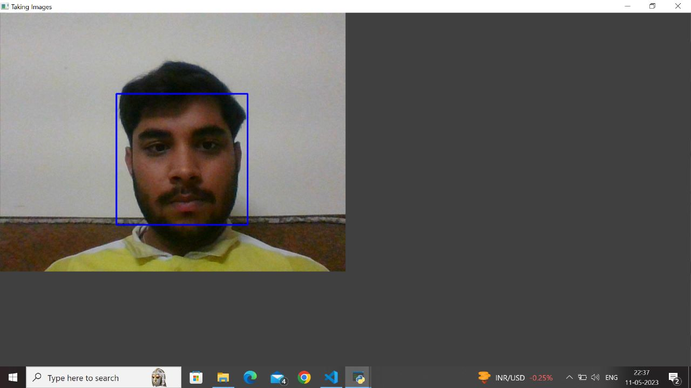

Slide 12
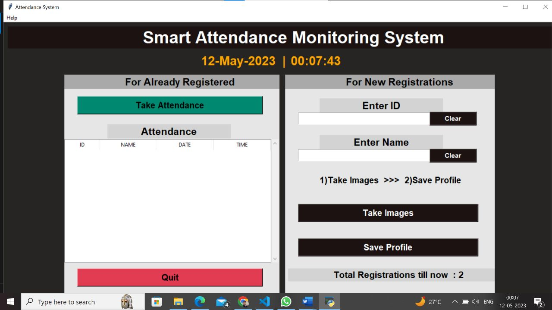

Slide 13


Slide 14
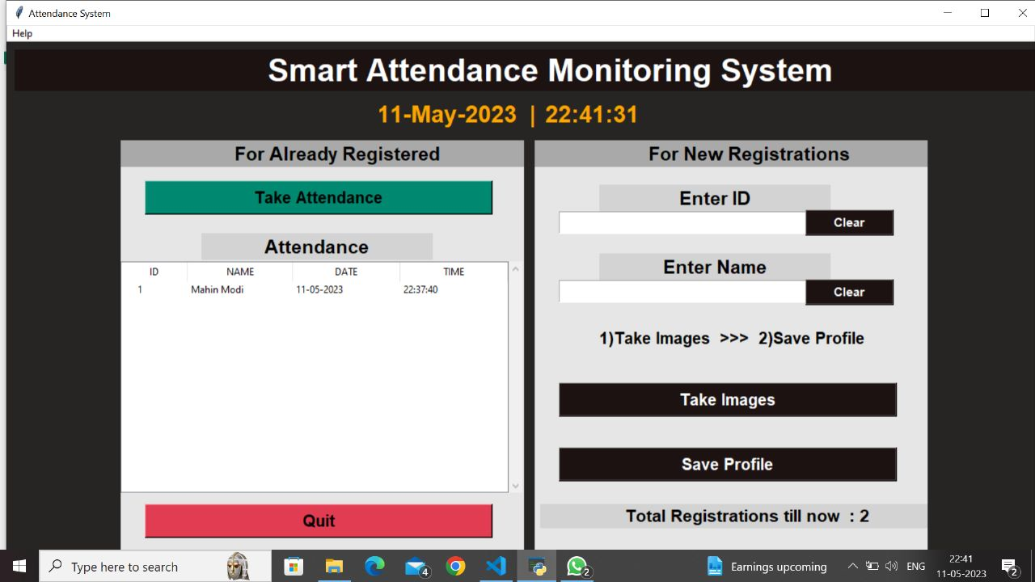

Slide 15
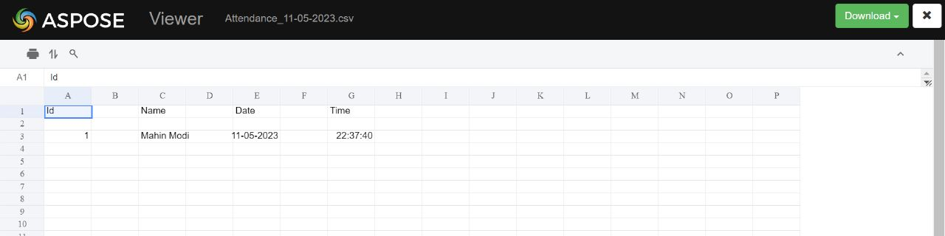

Slide 16
Conclusion
Automated attendance monitoring machine was the assignment selected with the aid of using us with the aid of using maintaining in view of the demand’s of day after day needs and wants of the society.
The advancements in generation lead us to suppose out of the container and give you a few concept that might be destiny changing. Education is the maximum crucial issue which anybody need to collect as it's miles the idea for a higher life-style and could definitely alleviate the popular of a living community.
What our schooling machine lacks is the involvement of college students withinside the schools, schools and universities. Instead of attending lectures and studying they prefer staying away from class and hold engaged in the use of those gadgets. Low attendance manner that the scholars and now no longer there to collect the information which they are supposed get and is of enormous importance for them and may cause them to a higher destiny

Slide 17
Future Scope
Improves accessibility of punch-in options with multiple devices like smartphones, desktops, and many more.
Records data accurately related to overtime or work done more than the scheduled hours.
Graphical representation of data offers a quick understanding of attendance data.
Real-time tracking multiple shifts becomes easier with the help of the geo attendance feature.
The cloud-based attendance system will be a massive shift from the conventional way of managing time-attendance. With excellent operational efficiency and a centralized data handling service, the modern-day cloud-based time-attendance system proves to be a considerable asset for organizations to modernize and automate their attendance management process.
Capturing the image/video in real-time from the camera.
· Detecting the faces in the image.
· Matching the faces with the uploaded entries in the database and marking the attendance of the person whose name is stored for the detected image.
Our customized smart attendance management system is an AI, Deep Learning-based facial recognition software that can detect faces with accuracy higher than 95%, record entry, and exit timings in real-time.

Slide 18
References
Face verification using error correcting output codes. In: Computer Vision and Pattern Recognition (CVPR01), IEEE Press. pp. 755- 760.
Dalal, N. and Triggs, B.: Histograms of oriented gradients for human detection. In: IEEE Computer Society Conference on Computer Vision and Pattern Recognition (CVPR). pp. 886–893. (2005)
Viola, Jones: Robust Real-time Object Detection, IJCV 2001
Nirmalya Kar and Ashim Saha ; Study of implementing automated attendance system using face recognition technique.
Kanti, Jyotshana, and Shubha Sharm. "Automated Attendance using Face Recognition based on PCA with Artificial Neural Network." International journal of science and research IJSR(2012)
MuthuKalyani, K., and A. VeeraMuthu. "Smart application for AMS using face recognition." Computer Science & Engineering 3.5 (2013): 13. [8] Deshmukh, Badal J., and Sudhir M. Kharad. "Efficient Attendance Management: A Face Recognition Approach." (2014).
Wagh, Priyanka, et al. "Attendance system based on face recognition using eigen face and PCA algorithms." 2015 International Conference on Green Computing and Internet of Things (ICGCIoT). IEEE, 2015.
Bhattacharya, Shubhobrata, et al. "Smart Attendance Monitoring System (SAMS): A Face Recognition Based Attendance System for Classroom Environment." 2018 IEEE 18th International Conference on Advanced Learning Technologies (ICALT). IEEE, 2018.

